Slide 1
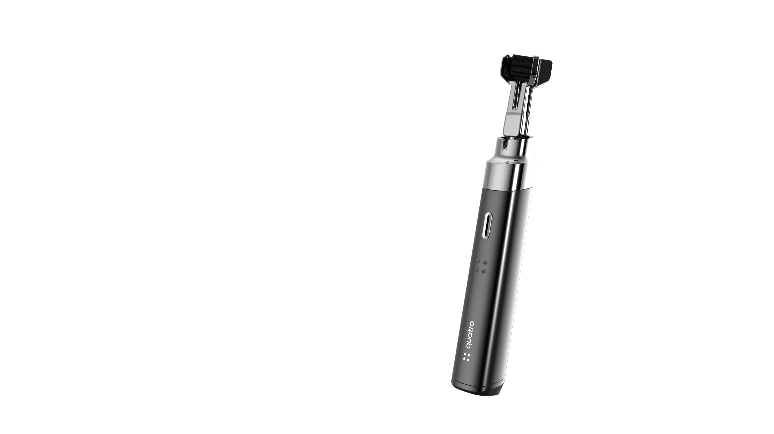
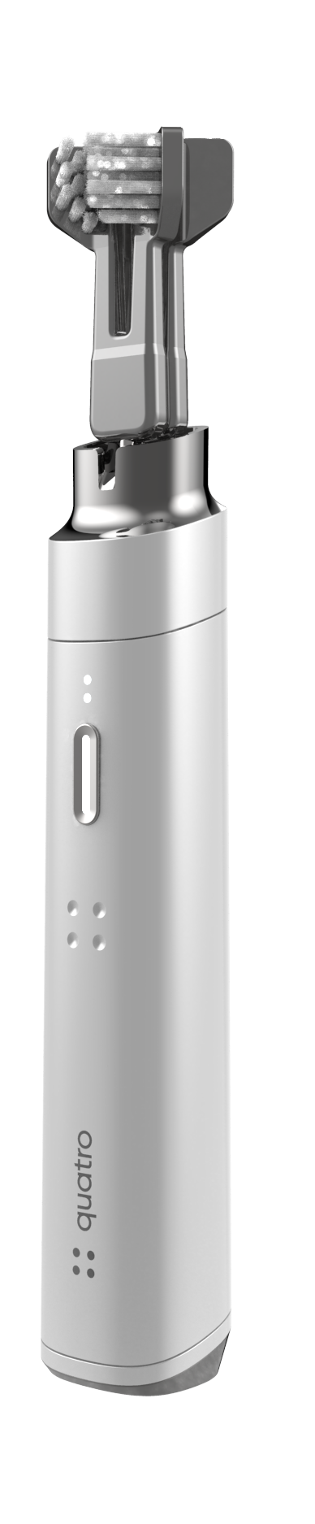


Investor Deck : 2021
Experience a new way to clean your teeth
Patent Protected Technology

Slide 2
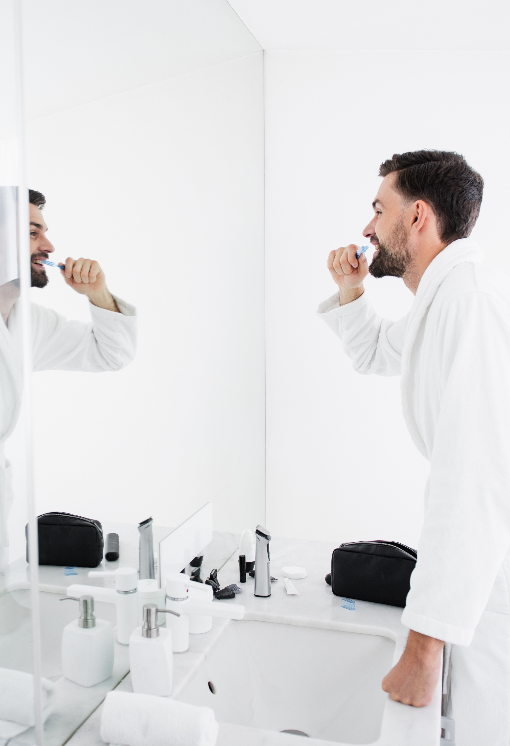
Introduction
2021 presents a timely opportunity to merge two decades of refined intellectual property, with a talented, strategic brand / R&D partner (RKS Design) and with a newly recruited, experienced and capable management team.
Further, market opportunities have expanded as several $300-400 vibrating, smart, single-headed toothbrushes have been accepted and are expanding recent market share. These developments allow Quatro to pursue plans to realize the financial returns that our existing shareholders deserve due to their commitment to developing the world’s most extraordinary brush.
Management plans to lead a re-positioning of this important intellectual property and land Quatro at the top of the premium toothbrush marketplace. Launching new product in 2022, management expects to reach 500,000 annual units at a $300 price point by 2025 through both subscription and point-of-sale direct-to-consumer business models. Management is pursuing new equity capital of $5 Mil to make this vision a reality.
2

Slide 3
About Quatro
20 years of product development
500,000 units sold garnering ample “field experience” and evolutionary learnings
Design evolution based on over a decade of performance analysis
Robust patent protections and extension opportunities
Rooted in Hydrabrush (quatro’s TopCo) and 30 Second Smile legacy
The culmination of our rich history, new strategic brand/R&D partnership, new seasoned management team and brush market pricing have created an epic opportunity.

Slide 4
Our Mission
Empowering everyone to improve their overall health through a revolutionary dental experience

Slide 5
The Market Opportunity
The relationship between poor oral health and systemic diseases can no longer be ignored in a world suffering from COVID-19
$3 Billion
By 2025, CAGR 6.2%
The prevalence of oral diseases and growing oral hygiene awareness are major factors propelling the electric toothbrush market growth
Single head, sonic, smart brushes made by Proctor & Gamble Oral B and Philips Sonicare are priced and sell above $300 each
$2.5 Billion
Global Toothbrush Market
Consumers continue to experience intrusive dental visits as their brushing technique does not serve their overall health
Sources: Electric Toothbrush Market Size, Share & Trends Analysis Report By End Use (Adults, Children), By Technology (Rotational, Vibrational), By Region, Competitive Landscape, And Segment Forecasts, 2019 – 2026, Grand View Research

Slide 6
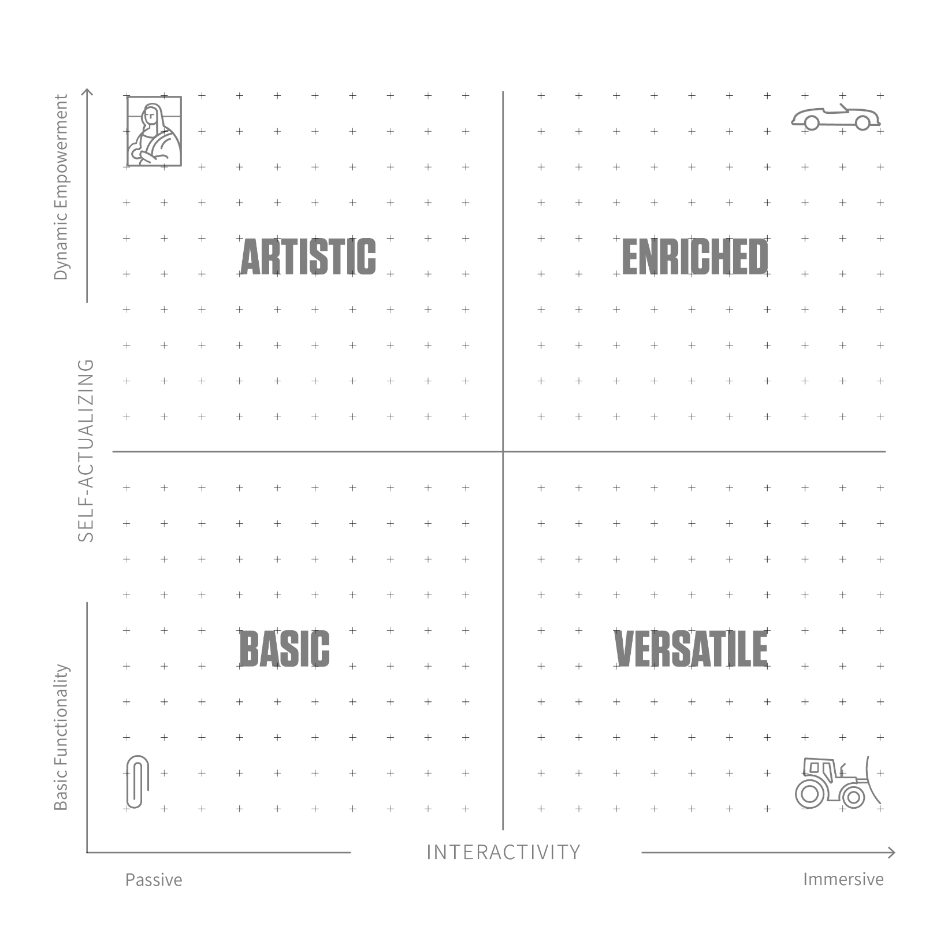
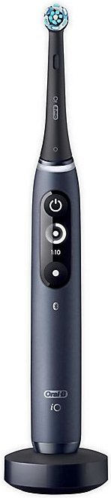
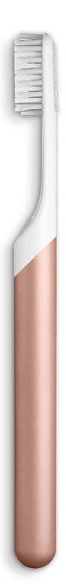
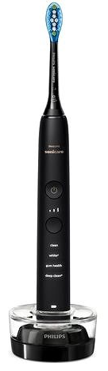
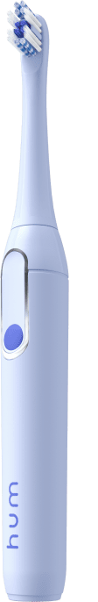


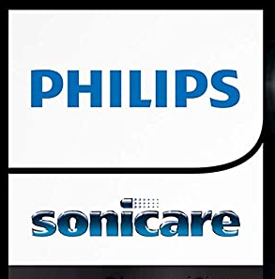

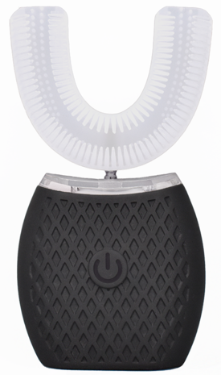

The Market Opportunity
Competitive landscape
OPPORTUNITY
ZONE
Once we observed the user journey and solution criteria, we used our Psycho-Aesthetics process to evaluate the market and identify an opportunity area to guide the design going forward.
The opportunity zone was determined by:
Competitive landscape
Untapped User Needs
Target Use Case
Emotional Engagement
Consumer Triggers
Persona solution Criteria
Price $40
Price $300
Price $350
Price $70
RKS utilizes Psycho-Aesthetics®, a proprietary design strategy framework based on Abraham Maslow’s “Hierarchy of Needs”, to strategically frame meaningful consumer experiences and game changing business opportunities. This simple to use framework enables the translation of peoples’ desires into visual context while providing direction for innovation teams throughout the process of a project. We use it to map consumer segments, position products, services and brands, analyze industry landscapes and to frame new business opportunities.
Price $60
6

Slide 7

The Quatro Advantage
Elevated Health Experience
  Clinically proven to be more efficient than single headed power toothbrushes
  Promotes gum health. There is a link between poor oral health and a range of medical conditions including cardiovascular disease, type 2 diabetes and Rheumatoid arthritis.
  Feel better about yourself
  Dental care becomes self care
  Eliminates human error
Save Precious Time
  30 seconds for a clinically superior clean by brushing 6 tooth surfaces at one time
  Take time back for yourself
Increased Self-Confidence
  Promotes self confidence knowing you are taking steps to a more beautiful and healthier you.
  Whiter teeth, fresher breath
A Premium Experience
  Improve the start and end of your busy day
  Sleek, Modern and Minimal
7

Slide 8
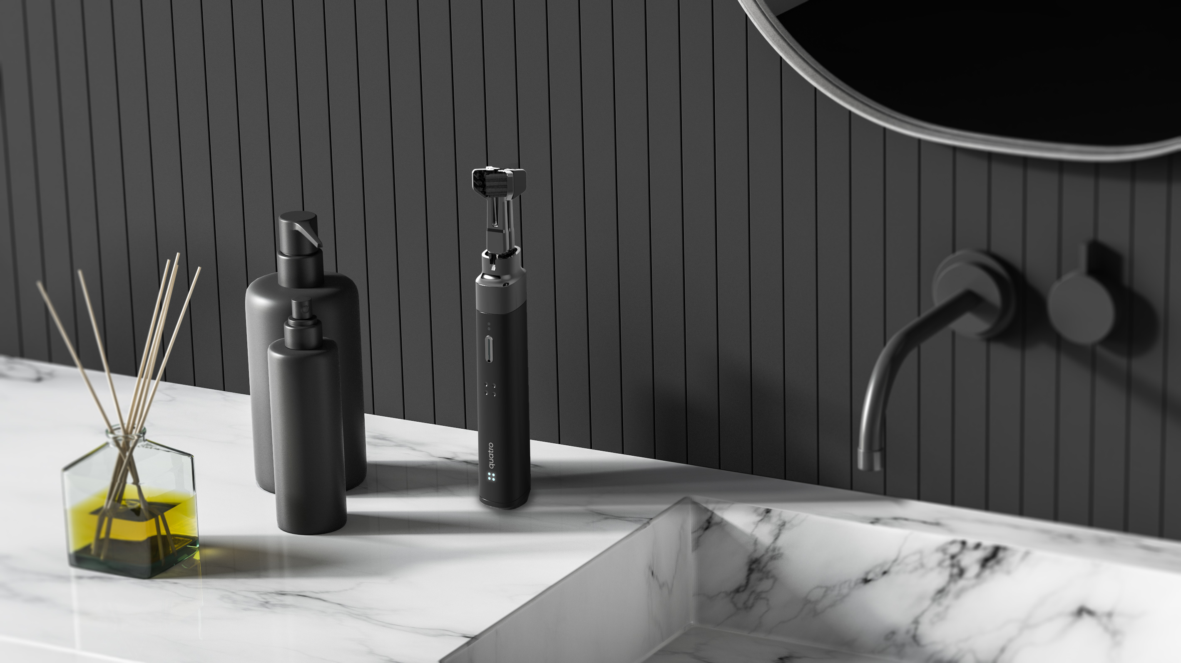
Premium Brand Build Out
Evokes an emotional response
Promoting self care and dental health
Highest quality design and material selection
  Extruded aluminum
  RKS Design
Precision fit and finish
Designed and “Made in USA”
Premium look and feel
Direct, high engagement marketing and customer journey
  Direct to Consumer
  High Impact Packaging, App, Website, Subscription Service
  Best in Class Lifetime Warranty / Guarantees
8

Slide 9
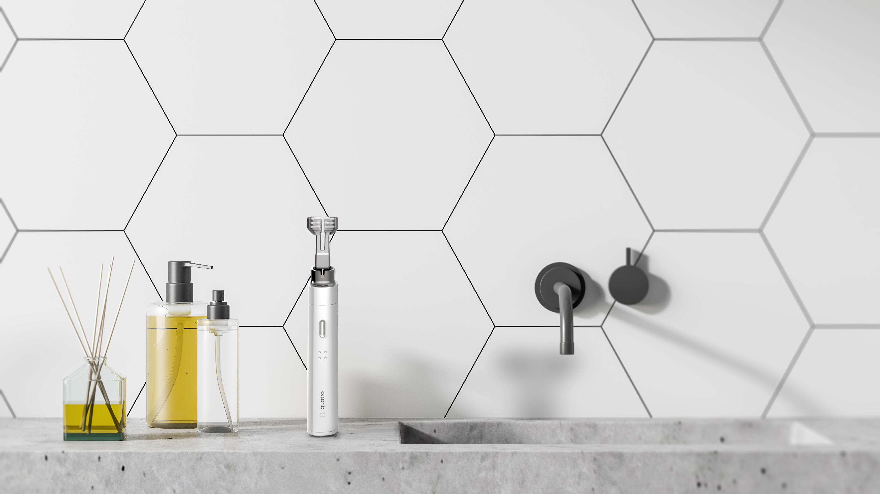
Enhanced Product Features
4 brush heads; 6 tooth surfaces brushed at once
Linear brush head movement
45 degree brushing angle
Gum line penetration
Multi speed functionality
Ergonomic design
Enhanced cleanability
Charging station
On the go carrying case
9

Slide 10
Go to Market Strategy
Brand Promise
Provide a self care experience that eclipses the worlds best
Values
Minimal, Functional, Precise, Honest
Channel Strategy
Direct to Consumer Subscription (Recurring Revenue Model)
Direct to Consumer Point of Sale
Premium Distributorship for Select Foreign Markets
Pricing
$25 per month incl brush, lifetime guarantee, quarterly, recurring brush heads
$300 per brush and two sets of brush heads
Further ancillary products and income streams to be continuously developed
Marketing Avenues
Social Media Influencer Gameplan
Media Platforms – Facebook, Instagram, TikTok
Direct Website exposure
Paid Advertisements
Google Ads

Slide 11
Quatro Development Roadmap
Q2/3 2021
Q4 2021
Q1 2022
Q2 2022
Q3 2022
Q4 2022
Q1 2023
Q2 2023
Quatro 1.0
Industrial Design
Design for Manufacture
Quatro 1.0
Launch
CM/Tooling
Testing
Debugging
Beta 200 Units
Branding and Packaging
Launch
Design Completion
Production incl. Approval Processes
E-Commerce / Social Media / D2C Marketing
Launch
UI/UX Wireframe
Alpha
Beta
Pre-selling Campaign
Accessories / Mouthwash / Toothpaste
Strategy
POC - Industrial Design
Product Development
Launch
CM/Tooling
Artisan Series
Launch
Launch
Launch
Launch
Strategy
Design Development
Product Development
Production
Tongue Cleaner
Launch
Strategy
POC - Industrial Design
Product Development
CM/Tooling
Testing and Debugging
Beta 200 Units
Floss Dispenser Cleaner
Continual Innovation and IP Development:
Water Jet or Oral Irrigation version, Other “Bathroom Sink” Innovations
Strategy
POC - Industrial Design
Design for Manufacture
Launch
CM/Tooling
Testing and Debugging
Beta 200 Units
11

Slide 12
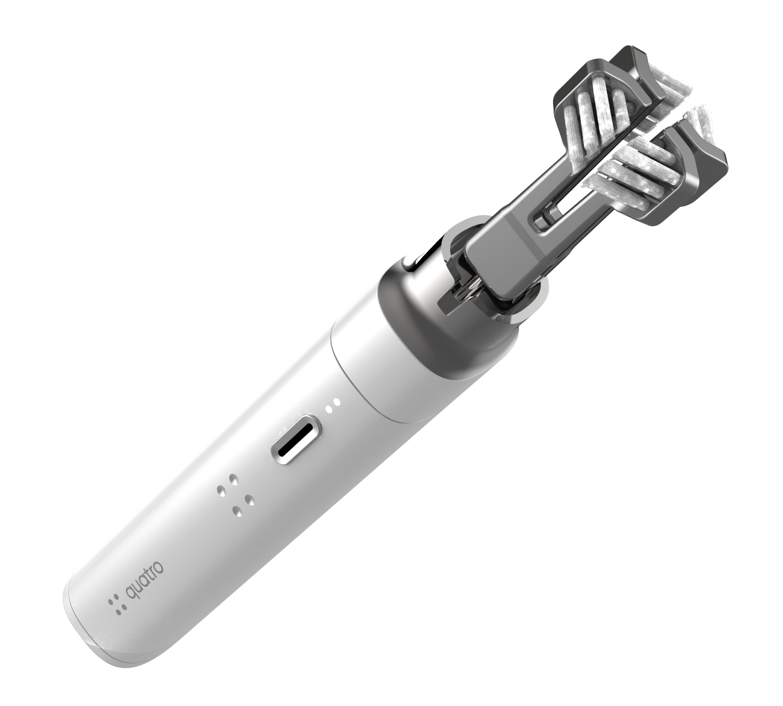
Technology
15 patents issued on present product, 3 pending.
Remaining life is average 8 years.
Our Founder is developing a new slim-line, more aesthetically pleasing and acceptable version of the product. He has applied for four completely new patents to protect this future version of the product.
The huge value of these new patents is that they will take the product into the next generation.
Functionally, it will operate and perform the same or better than the present 30 Second Smile and change the game regarding look and feel in the premium toothbrush space. It will be smaller and quieter.
Most exciting is the fact that it will give a new 20-year life to the Hydrabrush patent portfolio.
Our multi-year strategic product and design partnership with RKS Design will guide us through product marketing and design decisions.

Slide 13
Manufacturing and Supply Plan
01
Current Manufacturing
03
Made in the USA
Currently all internal components are manufactured in China. All previously used molds have been properly stored and with a proven track record of dependable functionality, we are confident we can continue using the previous internals for Gen 2.
With supply chain disfunction and unknown global conflict possible, we will be migrating our manufacturing back to the USA late 2022.
02
Partners
04
Experienced Teams
While our initial production run will be manufactured in China the team will continue developing our contract manufacturing partners in the USA.
RKS Design is exceptionally well versed at DFM engineering. With their 40+ year track record of success, we are highly confident there will be a seamless handoff from concept to design for manufacturing to the final approval of our contract manufacturing partners.

Slide 14
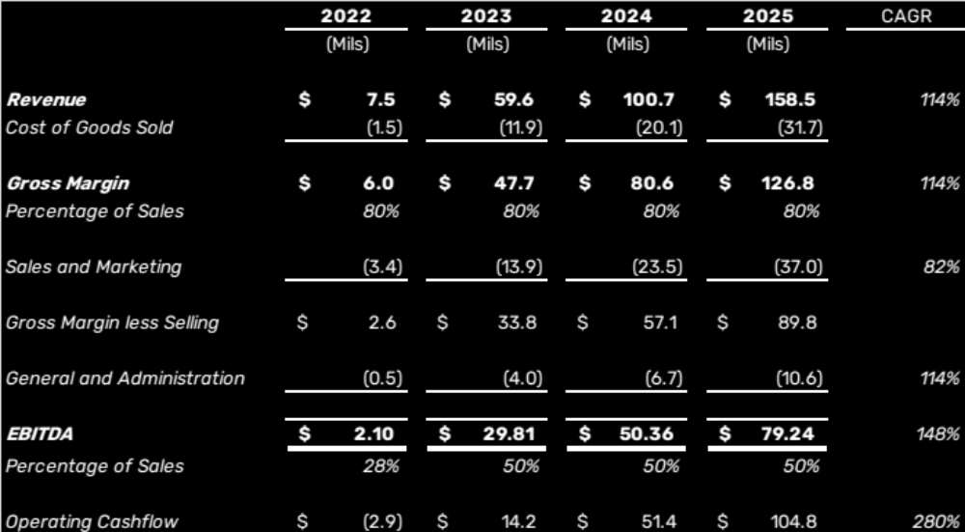
Financials
Raise $5 Mil equity capital by 1H2022
Full manufacturing launch by 2H2022
$1.5 Mil tooling and capital expenditures required
$1.7 Mil one- time social media and website marketing launch
Plan demonstrates dividend payment capability of $100-125 Mil with surplus 2024/25 cashflows
Plan suggests 2025 $2 Bil enterprise value on TTM earnings at 25x (less than P&G and Philips)

Slide 15
The Investment
Seeking USD 5 Million
Tooling For Gen 1 & 2
$1.5 Mil
Digital Marketing Launch
$1.7 Mil
Working Capital
$1 Mil
Design & Product Roadmap
$0.5 Mil
Overhead and general corporate purposes:
Funded through operating cashflow

Slide 16
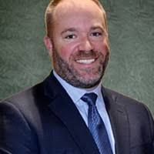
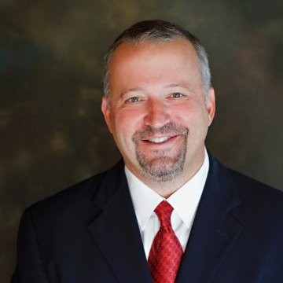
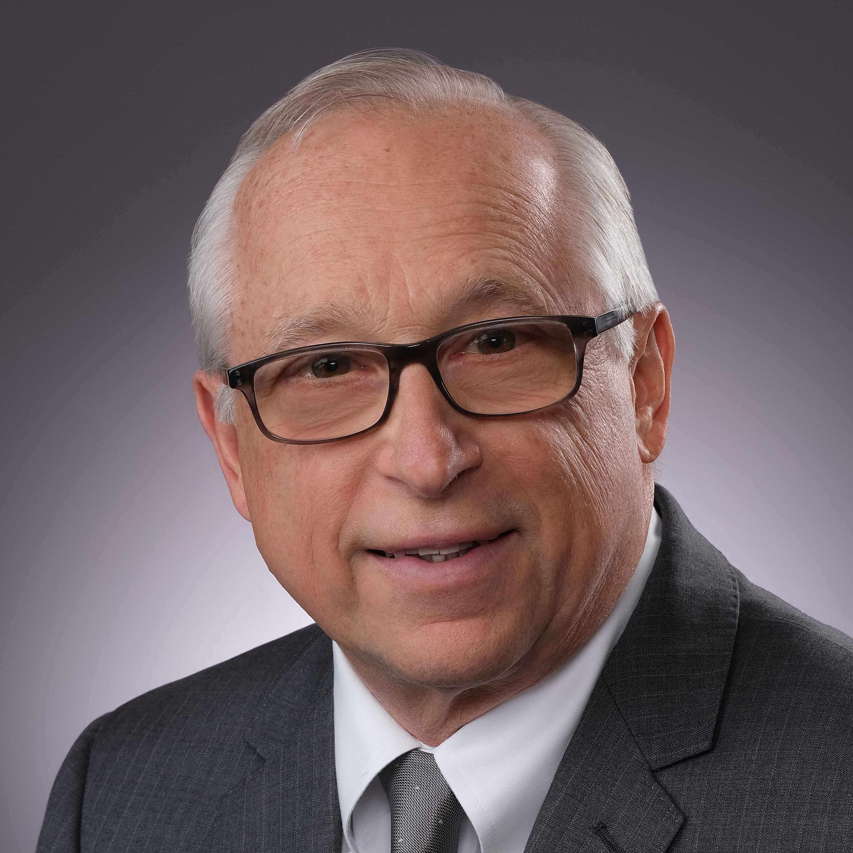
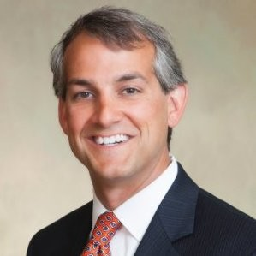
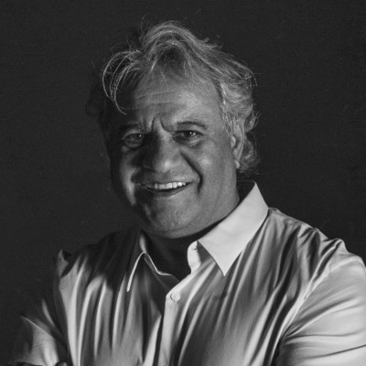
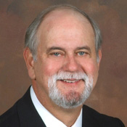
Management
Pat McCullough
CEO / Board Director
James Pickren
President / Board Director Nominee
Pat McCullough has 25+ years of progressive leadership experience. Pat's CEO experience includes a $4 Bil global, publicly traded retail energy company and a private, early-stage utility scale solar startup backed by Kleiner Perkins, Goldman Sachs, HSBC and others. He graduated from University of Notre Dame with a BS, Mechanical Engineering and an MBA, International Business. His career began at Ford Motor Company and Johns Manville, a Berkshire Hathaway Company in corporate finance and operating roles.
James Pickren is a corporate executive, investor and entrepreneur. Most recently he was the Chief Operating Officer for Just Energy Group, Inc. As such, Mr. Pickren had full responsibility for JE’s global gas, power, and renewables businesses with principal locations in Houston, Toronto, and London. Prior to this, Mr. Pickren was a principle and served as the Chief Executive Officer at Sherex Fastening Solutions, a manufacturer of specialty fastener hardware. Previously, Mr. Pickren was the President and Chief Executive Officer at Ryan Herco Flow Solutions, a NY based, private equity firm. Mr. Pickren has a mechanical engineering degree from Clemson University and an MBA from Duke University.
Don Zimmer
Chief Operating Officer / Board Director
Scott Storey
Chief Financial Officer
Don Zimmer is a 40-year veteran of the highly competitive new car Automotive industry. Don has been a Director of Fixed Operations for some of the most prestigious brands such as Rolls-Royce, Bentley, Ferrari, Lamborghini, and Maserati. Don shared his hard-won knowledge with Managers and Directors across the US and Canada as a Fixed Operations trainer and now, he brings his talents, organizational skills, and attention to detail to the Eclipse Quatro project.
Scott Storey has spent his entire career in the financial services industry in capital raising, M&A, and consulting capacities. Scott’s recent experience includes heading up acquisitions for a family office and prior to that as a Managing Director with BB&T Capital Markets advising companies on mergers and acquisitions. Scott graduated with a B.S. in Commerce from the University of Virginia and received an M.B.A from the University of North Carolina at Chapel Hill. Scott began his career with PriceWaterhouseCoopers.
Ravi Sawhney
Chief Design Officer / Board Director
Frank Caughman, DMD
Chairman of the Board
Coming 2021
Dental Advisory Board made of existing shareholders that are leaders in the Dentistry Space
Ravi Sawhney has spent more than forty years at the forefront of product and technology innovation. He is a serial entrepreneur, business leader, author, lecturer, and thought leader on design and innovation. He is also frequently asked to be an expert witness on matters of design, innovation, and competition. He is founder and CEO of RKS Design.
Dr. Frank Caughman is an accomplished Dental educator, researcher and clinician. In his 40+ year dental career, he has received numerous prestigious honors, authored more than 60 research and clinical publications, served as President of the Academy of Operative Dentistry, and retired from academia as the Associate Dean of Patient Services at the Dental College of Georgia.
16

Slide 17


Thank you
pat.mccullough@gmail.com

Slide 18
